Slide 1
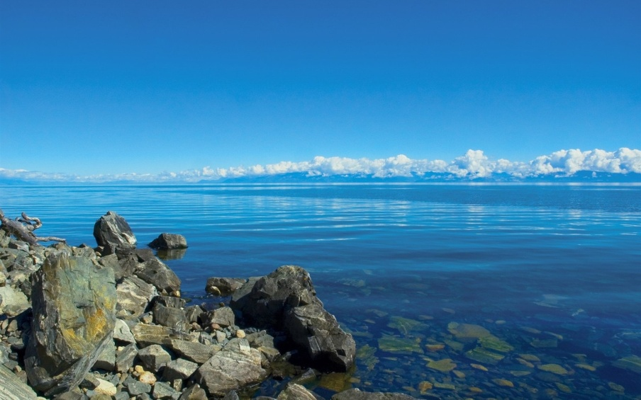
1) How is our amazing lake described in the poem? 2) What disobedient daughter is mentioned in the poem? 3) Guess the topic of our lesson
Oh, Great Baikal!
The world of gods – ezhinz,
the land of miracles and legends.
Where is your disobedient daughter? …

Slide 2
The legend of Baikal and his beautiful daughter Angara
Oh, Great Baikal!
The world of gods – ezhinz,
the land of miracles and legends.
Where is your disobedient daughter? …

Slide 3
Powerful Baikal
Many years ago there lived a formidable giant Baikal. He was a most powerful, valiant knight. He had countless treasures.

Slide 4
Merciless Olkhon
He had a subject whose name was Olkhon, who was a very merciless man and a faithful assistant.

Slide 5
The Beauty Angara
He had 333 obedient sons and an only daughter who wasted the riches of her father. Angara was a capricious beauty.
Baikal's daughter didn't have a beloved, and she was bored. And her father decided to find a fiancé for her.
Many knights wanted to be Baikal’s son – in – law. Angara refused them.

Slide 6
Irkut
One knight Irkut came there. Angara didn’t want to be his wife. But Baikal liked Irkut and he said: “You’ll be my son – in – law. I’ll help you”.

Slide 7
National holiday
Summer came. Every year people in Buryatia celebrated Surharban. That year a lot of people arrived at Baikal’s to take part in it.

Slide 8
Brave Yenisei
Fearless Yenisei came there too and was the winner of all the competitions there: archery, Buryat whrestling and horse racing.

Slide 9
Falling in love
When Angara saw Yenisey she fell in love with him at once. Yenisei was fascinated by Angara’s beauty. He came to her and said: “All my victories are for you, beautiful girl.”
When Yenisei had gone, Baikal proposed her to be Irkut’s wife. But she refused again.

Slide 10
Is it possible to find a force to hold love imprisoned?
When Baikal learnt about Angara's beloved, he ordered Olkhon to imprison her in a stone dungeon.
She broke the ring of the mountains, tossing great boulders about and when night fell she ran off to her beloved.

Slide 11
Disobedient daughter
When her father saw that she had left him
Enraged Baikal seized a fragment of a rock and threw it with all his might after Angara, but in vain.

Slide 12
Shaman rock.
Yenisei and Angara met and began live in love and happiness. Many years passed. Baikal, Angara, Yenisey and their tears were turned into water. Only Olkhon turned into a big stone. And the stone that Baikal had thrown at his daughter, people named Shaman rock.

Slide 13
Handout 1
Find someone in the legend and say who
… was brave, skilful and had fair hair.
… was pitiless, cunning but a devoted servant.
… was angry, strong, and had vast wealth.
… was charming, rebellious and had a sweet heart.
… was irresolute, cowardly but loved by the Master.
Fill in the gaps and tell the results.

Slide 14
Handout 2 Match the three verbs with the character of the legend.
Was bored, fall in love, escaped
Was obedient, imprisoned, was punished
Competed, won, was fascinated
Ordered, loved, threw
Came, wanted, was refused

Slide 15
Handout 3 Why did they do it?
She ran away from her dear father.
He threw the rock with all his might.
He gave all his victories for her.
He imprisoned her in a dungeon.
The young man went back home with a hope.

Slide 16
Handout 4 Answer these questions about the legend.
What kind of person was Baikal?
Did you like Olkhon? Why not?
What did Angara do during the story?
What is your attitude to Yenisey?
What is the main idea of the legend?
How can you characterize Irkut in one word?

Slide 17
What is cinquain?
Cinquain —it’s a five lines poetical form in a Japanese style. In the first line there should be a noun, a pronoun or a proper name expressing the main idea of the cinquain. The second line – two adjectives or participle describing characteristics of the chosen topic. The third line - three verbs or participles describing actions of the topic. The fourth line – a four word sentence expressing your attitude to the character. The fifth line – one word describing the point of the topic.

Slide 18
Handout 5 A cinquain example
House nice, expensive. is built, rented, sold. Somebody lives in it. Building.

Slide 19
A cinquain example
Yenisey
Fair - haired, handsome.
Came, saw, won.
He is liked by girls.
Hero.

